Slide 1
Container Orchestration with Kubernetes
Srinivas Lingampelli
RollNo : 23BD5A0504
CSE - A

Slide 2
Agenda
Introduction to Traditional Application Deployment
Problems with Monolithic Deployments
Introduction to Docker
What Are Containers?
Need for Container Orchestration
Introduction to Kubernetes
Kubernetes Architecture
Kubernetes Key Concepts (Pods, Services, Ingress, etc.)
Advantages & Limitations
Use Cases & Industry Adoption

Slide 3
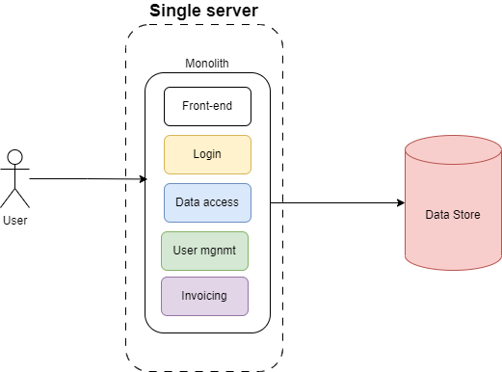
Traditional Application Deployment
Monolithic architecture is a software design where an entire application is built as a single, unified unit with a single codebase, deployed as one large artifact
On-Premise Monolithic Apps
Apps bundled into a single package
Deployed on physical servers or VMs
Problems:
High resource usage
Scaling issues
Downtime during updates
Environment mismatch ("works on my machine" problem)

Slide 4
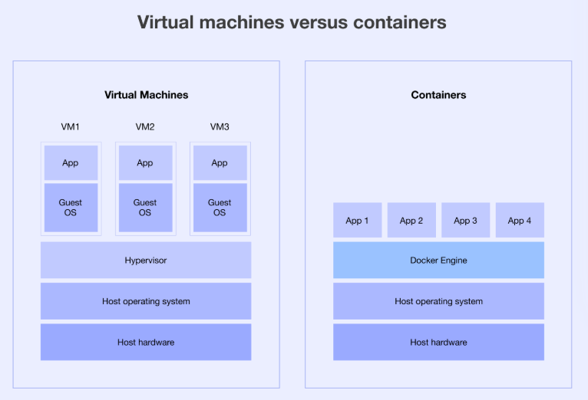
Evolution Towards Containerization
Containerization is a process in software development that packages an application's code, libraries, and dependencies into a single, isolated unit called a container. These containers share the host operating system's kernel, making them lightweight and portable, so the application can run consistently across different computing environments without conflicts or the need for a separate operating system for each
Why Containers?
Lightweight and portable
Consistent environment
Faster deployment and scaling

Slide 5
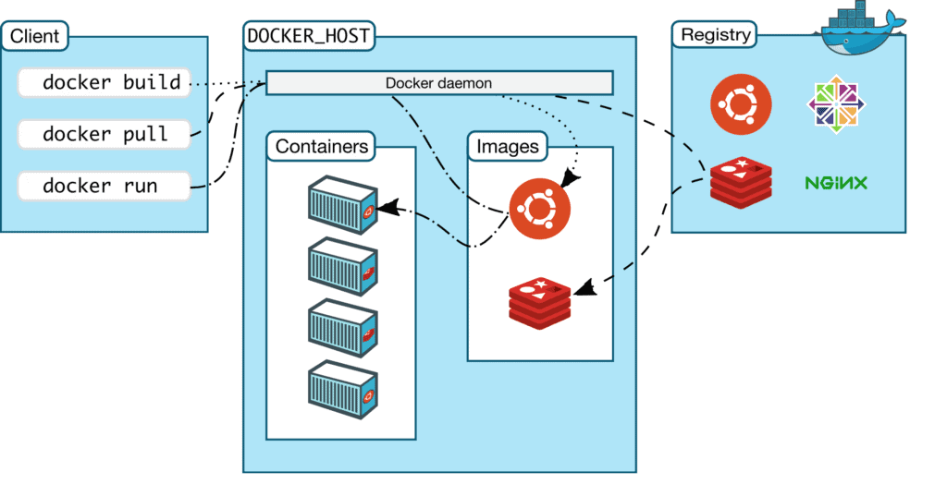
Introduction to Docker
Docker is an open-source platform designed to simplify the development, deployment, and running of applications by utilizing containers.
Components of Docker :
Docker Engine
Docker Image
Docker Hub
Dockerfile

Slide 6
Container Orchestration
Container orchestration is the automated process of deploying, scaling, managing, and networking containerized applications to ensure they run efficiently and reliably across distributed environments
It automates the entire container lifecycle, simplifying complex operations like resource allocation, load balancing, and high availability, which are challenging to manage manually at scale.
Popular tools like Kubernetes automate these processes, providing a framework for managing hundreds or thousands of containers for applications built on microservices and cloud-native architectures.

Slide 7
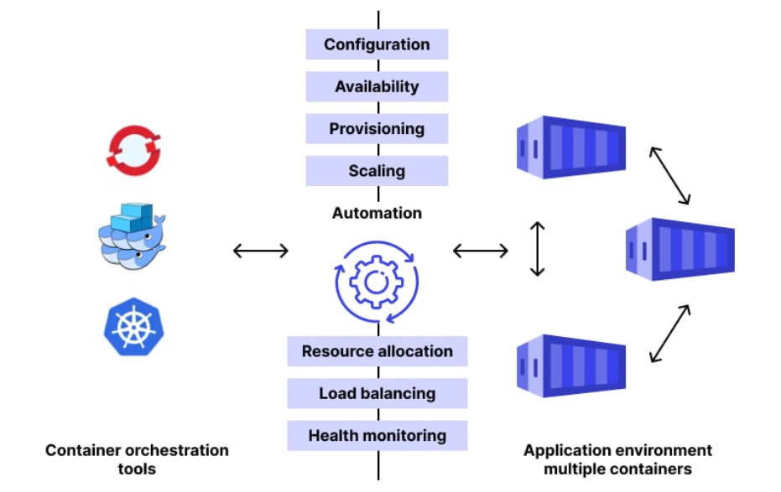
Why Is Container Orchestration Needed?
Physically or with straightforward scripting, you can accomplish container management errands with a small number of system packages. However, this gets increasingly challenging as the number of containers grows. As a result, this is a prime use case for CO security software.
Other tools, such as Kafka, can be used to facilitate communication between containers.

Slide 8
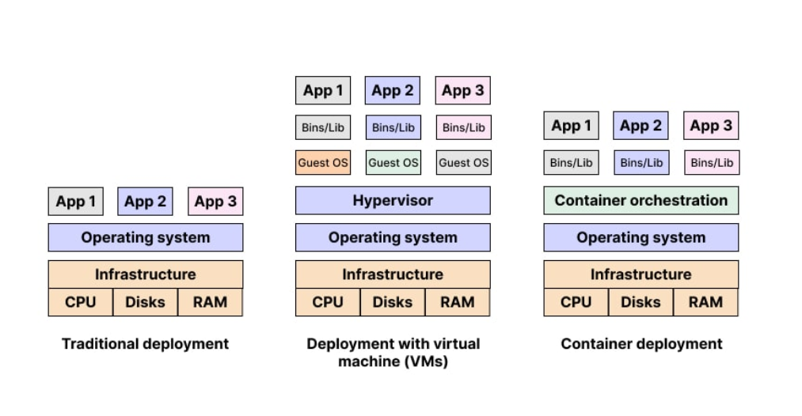
Traditional Deployment vs VMs vs Containers

Slide 9
Kubernetes Architecture
Kubernetes architecture is a distributed system designed to manage and orchestrate containerized applications. It operates on a master-worker model, consisting of a Control Plane and Worker Nodes.
A Kubernetes cluster is composed of several key components that work together to manage and orchestrate containerized applications. These components are broadly categorized into the Control Plane and Node Components.

Slide 10
Kubernetes Architecture
Control Plane Components: These components manage the cluster and make global decisions.
Kube-API Server:
The front-end to the Kubernetes control plane, exposing the Kubernetes API. All communication with the cluster happens through this component.
etcd:
A consistent and highly available key-value store used as Kubernetes' backing store for all cluster data.
Kube-Scheduler:
Watches for newly created Pods with no assigned node and selects a node for them to run on.
Kube-Controller-Manager:
Runs various controller processes, such as the Node Controller (manages nodes), Replication Controller (maintains the correct number of Pods), and Endpoint Controller (populates Endpoint objects).
Cloud-Controller-Manager (Optional):
Integrates with cloud provider APIs to manage cloud-specific resources like load balancers and persistent volumes.

Slide 11
Kubernetes Architecture
Node Components: These components run on each worker node and are responsible for running Pods and interacting with the control plane.
Kubelet:
An agent that runs on each node in the cluster, ensuring that containers are running in a Pod. It communicates with the Kube-API Server.
Kube-Proxy:
A network proxy that runs on each node, maintaining network rules on nodes and handling network communication for Pods.
Container Runtime:
The software responsible for running containers

Slide 12
Kubernetes Architecture
A Kubernetes Pod represents the smallest deployable unit in Kubernetes.
It is an abstraction that encapsulates one or more application containers (such as Docker containers), along with shared resources like storage volumes, a unique IP address, and information about how to run the containers

Slide 13
Advantages of Kubernetes 1. Auto-scaling and self-healing 2. Rolling updates without downtime 3. Multi-cloud compatibility 4. Declarative configuration (YAML) 5. Efficient resource utilization 6. Automation

Slide 14
Disadvantages / Challenges 1. Complex learning curve 2. Requires strong DevOps knowledge 3. High setup & maintenance costs 4. Debugging distributed apps is harder

Slide 15
Conclusion 1. The evolution from traditional monolithic applications to containerized microservices has completely transformed the way we develop, deploy, and scale modern applications. 2. Docker solved the problem of portability by enabling applications to run anywhere, but managing hundreds or thousands of containers manually became complex. 3. Kubernetes emerged as the industry-standard container orchestration platform, offering:
Automated deployment and scaling Load balancing and self-healing Efficient resource utilization Cloud-native compatibility
Today, Kubernetes powers cloud computing, DevOps pipelines, AI/ML workloads, and microservices architectures for companies worldwide.

Slide 16
Thank you

